Slide 1
Analog Signal Capture Using FPGA and USB Interface
Robert C DeMott II
Jeremy A Cooper

Slide 2
Outline
Project & Hardware Overview
Brief USB Protocol Overview
Cypress USB Peripheral Controller
Digilent USB Protocol
Digilent Data Transfer Example VHDL
Modified Data Transfer VHDL
ADC Hardware
ADC Driver
Block FIFO Implementation
Modified USB Protocol for ADC
C# PC Application

Slide 3
Project Overview
Transfer sampled ADC data over USB to PC Application
Run ADC at 1 million samples per second
USB transfer must be at least 2MB/s
USB communication using Nexys2 Board and Cypress chip
PC Application written in C# using Digilent communication driver

Slide 4
Hardware
Windows PC
Digilent Nexys2 Board
  Cypress CY7C68013A High-Speed USB Peripheral Controller
Digilent FX2 Module Interface Board
Analog Control System Board
  Analog Devices AD7980 ADC
TLA721 Tektronix Logic Analyzer Mainframe (for testing)

Slide 5
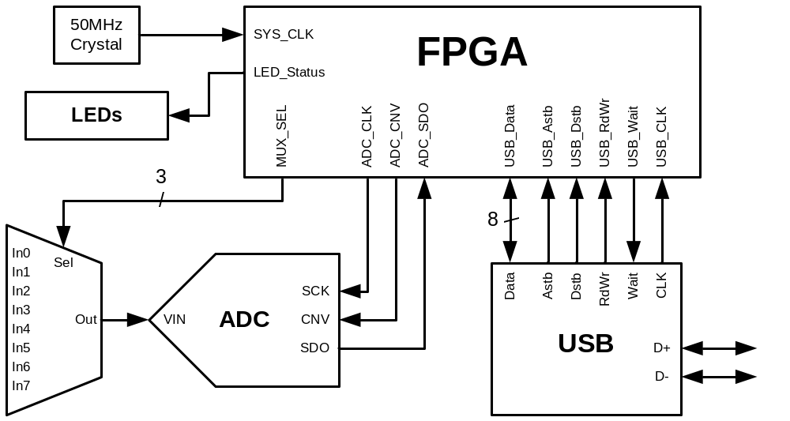
System Block Diagram

Slide 6
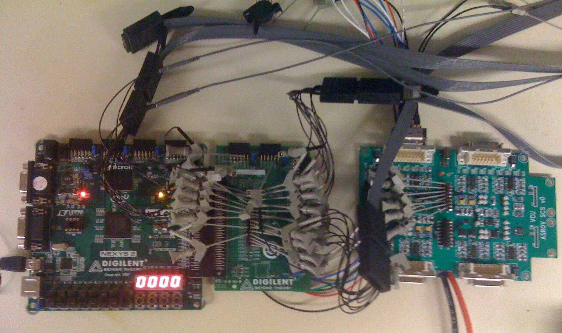
USB ADC System

Slide 7
USB Protocol Overview
USB is a serial protocol involving one host and multiple peripherals in a star topology
USB communication based on logical channels between the host controller and an endpoint, called a pipe
An endpoint is a logical entity on the peripheral device
Multiple endpoints are grouped into interfaces
Each endpoint is unidirectional
When a USB device is connected to a host, the enumeration process occurs to assign it a unique 7-bit address
  Device drivers are optionally loaded on the host and the device is set to a configured state

Slide 8
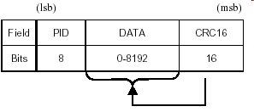
USB Protocol Overview
USB cables use half duplex differential signaling in a twisted pair data cable
The host polls the bus periodically for traffic
Host controller initiates all communication and must explicitly request data from a peripheral
All data is transmitted in packets
Bit stuffing is performed on strings of 1s, so certain bit strings take longer to transmit
Each packet may contain
between 0 – 1024 bytes
in the payload

Slide 9
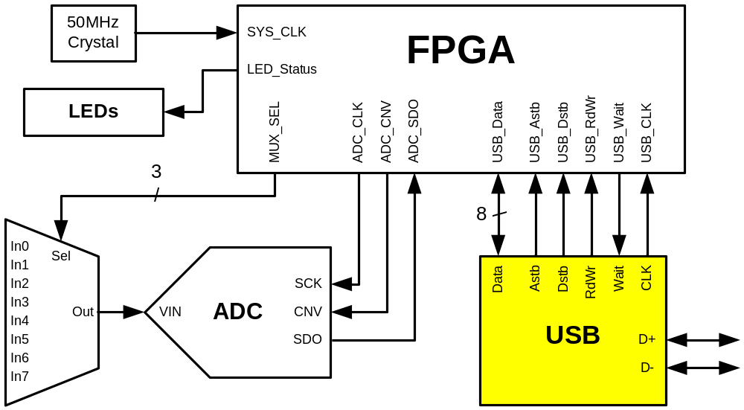
USB Subsystem

Slide 10
CY7C68013A Capabilities
USB 2.0 high-speed certified
8 or 16 bit external data interface
4 programmable endpoints
GPIF (General Programmable Interface)
Integrated enhanced 8051
  Up to 48MHz CPU operation
  4 clocks per instruction cycle
  I²C Controller
  4 Integrated FIFOs

Slide 11
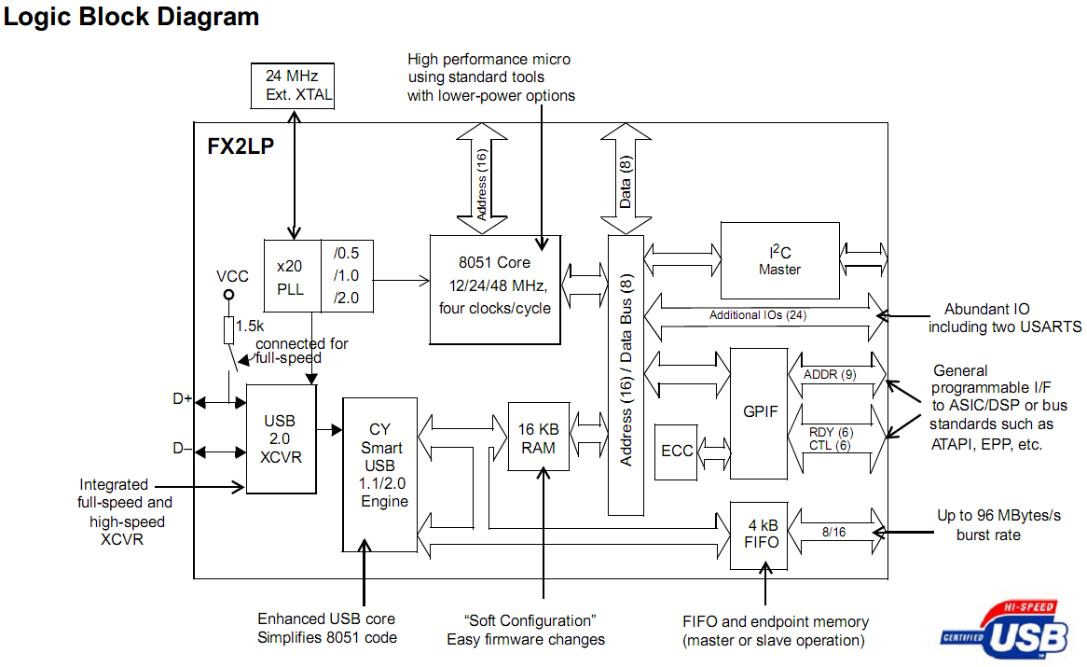
CY7C68013A Block Diagram

Slide 12
Cypress Chip Operating Modes
There are 3 modes of operation of the FX2
  Port I/O
    Use the internal 8051 to process USB data directly
  Slave FIFO
    Endpoint FIFOs are controlled by an external master
  GPIF (General Programmable Interface)
    GPIF acts as an internal FIFO master when connected to external logic that doesn’t have a standard FIFO interface

Slide 13
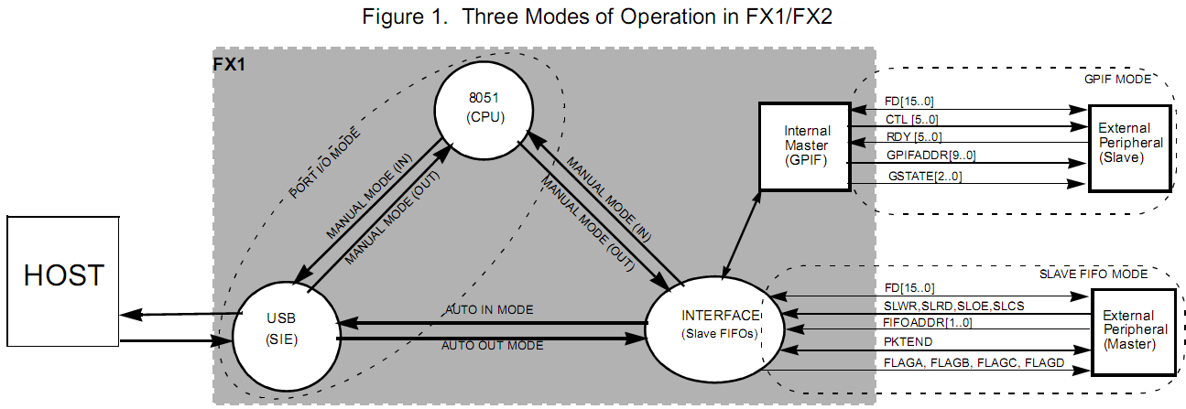
Cypress Chip Operating Modes
Digilent seems to use the slower Port I/O Mode
Slave FIFO Mode is best for high speed transfer (in Auto Mode)

Slide 14
Enable Higher Speed Transfers
Enable Slave FIFO mode and AUTOIN and AUTOOUT for IN/OUT endpoints
  AUTOIN: When complete packet arrives from FPGA, immediately/automatically send to USB domain (bypass 8051)
  AUTOOUT: When complete packet arrives from host, immediately/automatically send to interface domain (bypass 8051)
Uses multi-buffered “quantum FIFOs” to improve transfer speeds

Slide 15
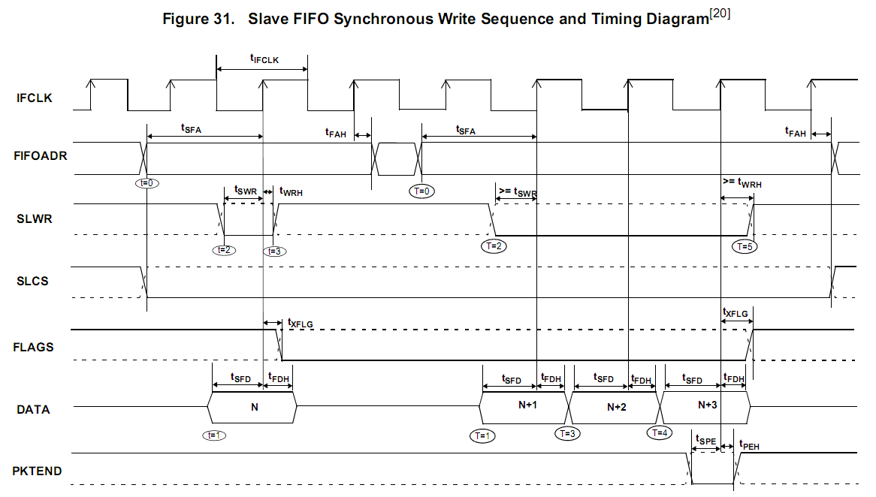
Slave FIFO Synchronous Write Timing

Slide 16
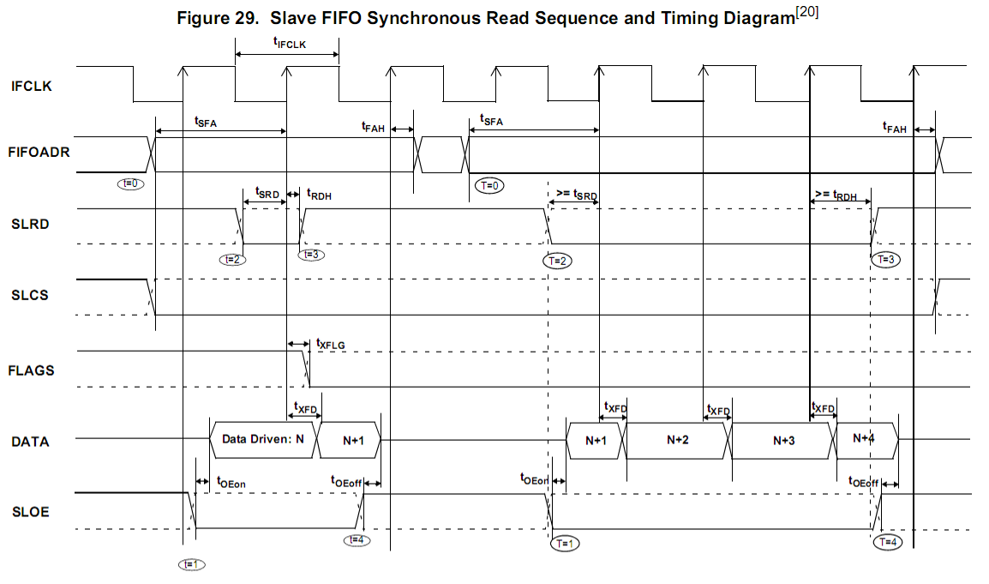
Slave FIFO Synchronous Read Timing

Slide 17
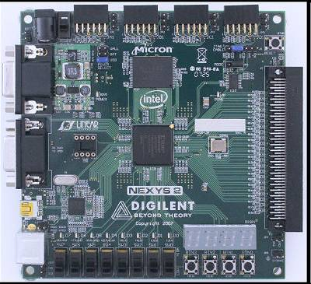
Cypress Nexys2 USB Interface
Cypress CY7C68013A

Slide 18
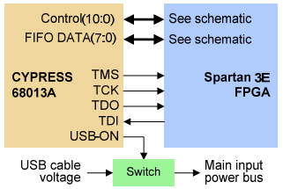
Cypress Nexys2 USB Interface
The Cypress chip enables the following features on the Nexys2:
  Provide power over USB (up to 500mA)
  Program FPGA by emulating JTAG over USB
  General purpose
  user-data transfers
  Ability to overwrite
  firmware & bypass
  Digilent’s protocol
  (hardware modification)

Slide 19
Nexys2 USB Interface
8 Bidirectional Data Pins
6 Control Pins
  Write: 0=write to FPGA, 1=read from FPGA
  Address Strobe: 0=read/write from/to address register
  Data Strobe: 0=read/write from/to data register
  Wait: 1=ready to read/write data, 0=transfer cycle complete
  Interrupt & Reset pins are not used in this design
Clock Pin
Other miscellaneous Cypress Pins

Slide 20
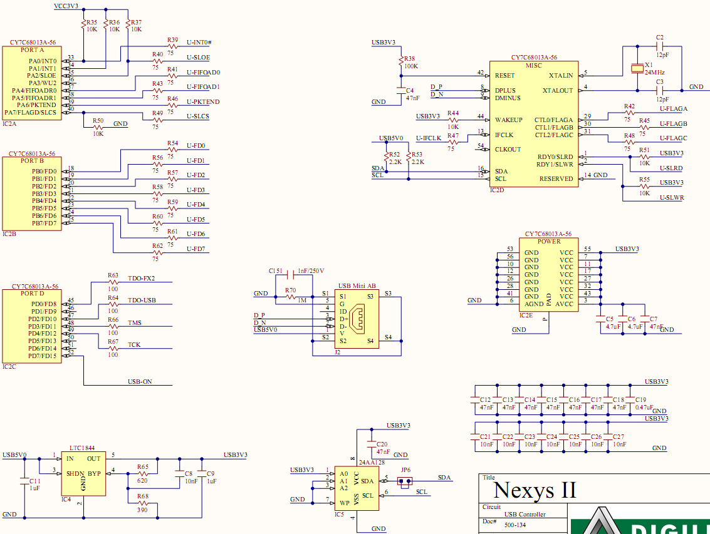
Nexys2 USB Schematic

Slide 21
Digilent USB Protocol
Digilent has custom firmware on the CY7C68013A to emulate a PC parallel port using EPP (Enhanced Parallel Port) protocol
Uses 1 address register & a set of 8-bit wide data registers
Communication is done in 4 transfer cycle types:
  Address Read
  Address Write
  Data Read
  Data Write
Data read or write cycles read from (write to) a register specified by address register

Slide 22
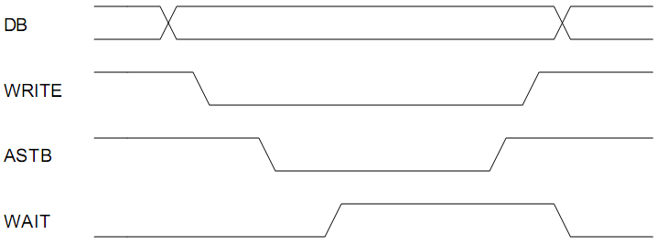
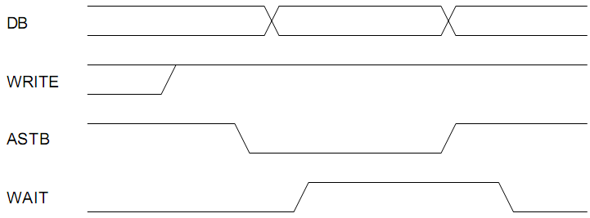
Digilent Address Write/Read
Address Write
(PC->FPGA)
Address Read
(FPGA->PC)

Slide 23
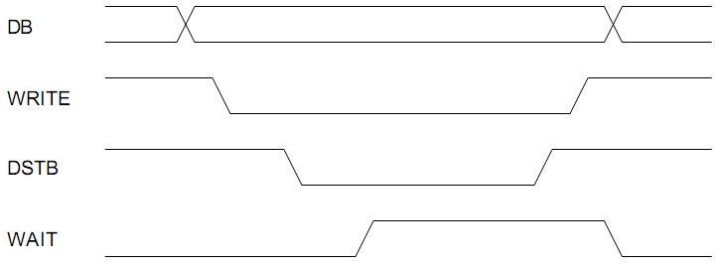
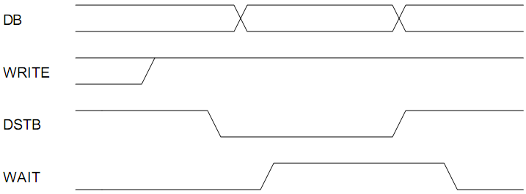
Digilent Data Write/Read
Data Write
(PC->FPGA)
Data Read
(FPGA->PC)

Slide 24
Digilent Example VHDL
Modified example from Echelon Embedded designed specifically for Nexys2
Contains several registers
  LEDs (0x00)
  Switches (0x01) (read-only)
  Buttons (0x02) (read-only)
  SSD (0xFF:0xFE)
Reads or writes data and address registers based on state machine

Slide 25
Digilent USB Protocol State Machine
Machine contains 3 inputs:
  Astb: address strobe (active low)
  Dstb: data strobe (active low)
  Pwr: write pin (1=FPGA->USB, 0=USB->FPGA)
Machine contains 4 outputs:
  Awr: write address (internal variable)
  Dwr: write data (internal variable)
  Dir: data direction (1=FPGA->USB, 0=USB->FPGA)
  Wait: wait pin (synchronization signal)

Slide 26
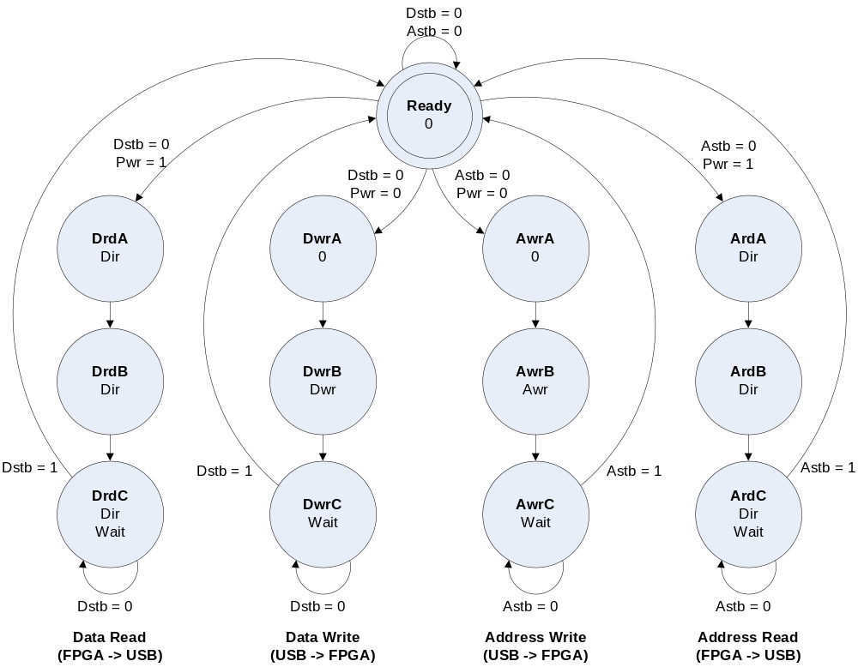
Digilent USB Protocol State Machine

Slide 27
State Machine Definition
constant stEppReady : std_logic_vector(7 downto 0) := "0000" & "0000";
constant stEppAwrA : std_logic_vector(7 downto 0) := "0001" & "0000";
constant stEppAwrB : std_logic_vector(7 downto 0) := "0010" & "0100";
constant stEppAwrC : std_logic_vector(7 downto 0) := "0011" & "0001";
constant stEppArdA : std_logic_vector(7 downto 0) := "0100" & "0010";
constant stEppArdB : std_logic_vector(7 downto 0) := "0101" & "0010";
constant stEppArdC : std_logic_vector(7 downto 0) := "0110" & "0011";
constant stEppDwrA : std_logic_vector(7 downto 0) := "0111" & "0000";
constant stEppDwrB : std_logic_vector(7 downto 0) := "1000" & "1000";
constant stEppDwrC : std_logic_vector(7 downto 0) := "1001" & "0001";
constant stEppDrdA : std_logic_vector(7 downto 0) := "1010" & "0010";
constant stEppDrdB : std_logic_vector(7 downto 0) := "1011" & "0010";
constant stEppDrdC : std_logic_vector(7 downto 0) := "1100" & "0011";
--4 MSbits are state number
--4 LSbits are outputs in the following order:
-- Dwr, Awr, Dir, Wait

Slide 28
Output Bus Assignment
busEppData <= regLed when regEppAdr = x"00" else
rgSwt when regEppAdr = x"01" else
"000" & rgBtn when regEppAdr = x"02" else
regUsr1 when regEppAdr = x"FE" else
regUsr2 when regEppAdr = x"FF" else
"00000000";
busEppOut <= regEppAdr when Astb = '0' else busEppData;
pdb <= busEppOut when Pwr = '1' and Dir = '1' else "ZZZZZZZZ";
--pdb is the tristate data bus
--regEppAdr is the address register
--other reg* or rg* are the registers for the buttons, LEDs, switches, SSD
--Pwr is the write pin
--Dir is the data direction (1=FPGA->USB, 0=USB->FPGA)

Slide 29
Modified State Machine
Several problems with the original design
  The extra states are unnecessary when using the 48MHz USB clock
  The state and variable names are unintelligible
  Only a handful of registers are actually used in the address space
We modified the state machine and the register set to read from (write to) BRAM

Slide 30
Improved USB State Machine
Machine contains 3 inputs:
  addressStrobePin: address strobe (active low)
  dataStrobePin: data strobe (active low)
  fpga2UsbPin: write pin
  (1=FPGA->USB, 0=USB->FPGA)
Machine contains 6 outputs:
  OutputEnable: output enable
  WaitOutput: wait output pin
  AddressDataMux: (0=output address, 1=output data)
  RamWriteEnable: enable writing to BRAM
  AddressUpdateEnable: update address register
  RamReadEnable: enable reading from BRAM

Slide 31
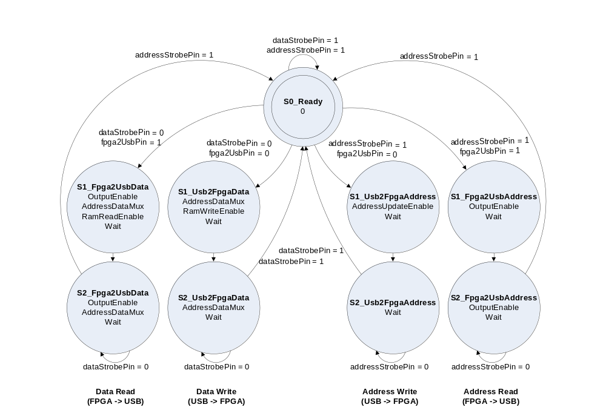
Improved USB State Machine

Slide 32
Modified State Machine & BRAM
type state_type is (s0_Ready,
s1_Fpga2Usb_Data, s1_Fpga2Usb_Address,
s1_Usb2Fpga_Data, s1_Usb2Fpga_Address,
s2_Fpga2Usb_Data, s2_Fpga2Usb_Address,
s2_Usb2Fpga_Data, s2_Usb2Fpga_Address);
signal currentState : state_type := s0_Ready;
signal nextState : state_type := s0_Ready;
attribute fsm_encoding : string;
attribute fsm_encoding of currentState : signal is "auto";
attribute safe_implementation: string;
attribute safe_implementation of currentState : signal is "yes";
--256 bytes ram
type ram_type is array(0 to 255) of std_logic_vector(7 downto 0);
signal testRam : ram_type := (others => (others => '0'));

Slide 33
Modified Data Assignments
MemoryProcess : process(usb_clock) --ram control process
begin
if(rising_edge(usb_clock)) then
if(ramWriteEnable = '1') then
testRam(conv_integer(usbAddressRegister)) <= dataIn;
end if;
if(ramReadEnable = '1') then
dataOut <= testRam(conv_integer(usbAddressRegister));
end if;
end if;
end process;
AddressProcess : process(usb_clock)
begin
if(rising_edge(usb_clock)) then
if(addressUpdateEnable = '1') then
usbAddressRegister <= dataIn;
elsif(ramWriteEnable = '1' or ramReadEnable = '1') then
usbAddressRegister <= usbAddressRegister + 1;
else
usbAddressRegister <= usbAddressRegister;
end if;
end if;
end process;

Slide 34
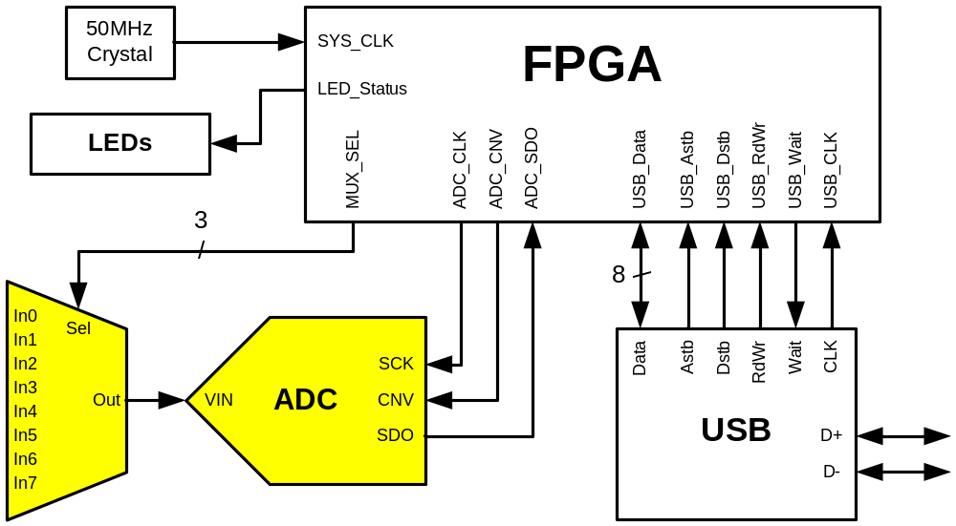
Analog to Digital Conversion

Slide 35
Analog Capture Board
External PCB containing Op Amps and ADCs used to acquire analog data.
Designed to test various analog filter components and configurations for VCU’s next generation flight control system.
  System will ultimately be used to interface several analog sensors (barometric pressure, infrared, etc) with the FCS.
Board contains four similarly designed quadrants.

Slide 36
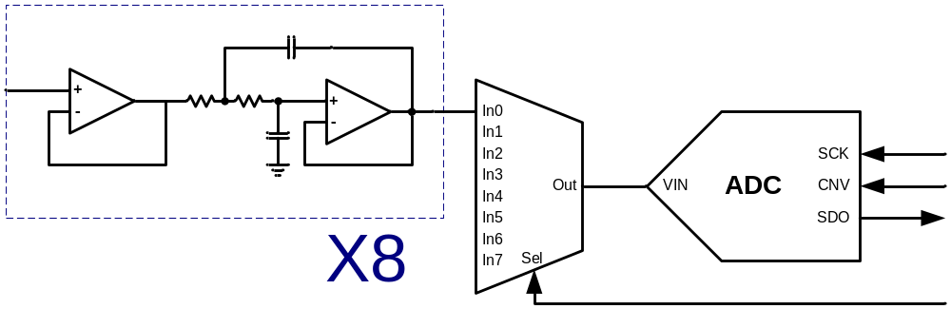
Analog Capture Board
Each quadrant contains:
  8 buffered analog input channels (0 to 5V)
  8 low pass anti-aliasing filters (2-pole Bessel configuration)
  8 to 1 channel analog multiplexer (MAX4617)
  Low noise, 1MSps 16-bit ADC (AD7980)
  Low noise voltage references & regulators (2.5V, 5.0V and 5.5V)

Slide 37
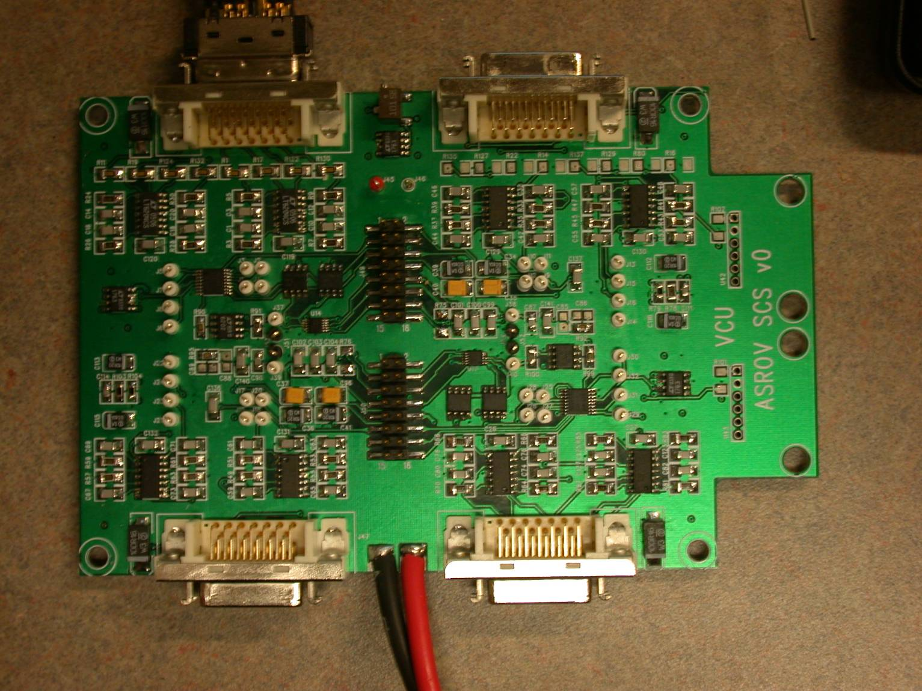
Analog Capture Board

Slide 38
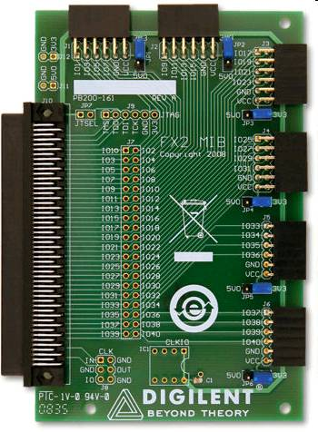
FX2 Interface Module
The Digilent FX2 interface module is used to connect the analog capture board with the Nexys2.
This module also provides connections for logic analyzer probes used to debug the system.

Slide 39
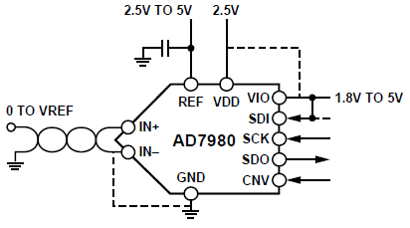
Analog to Digital Converter
Analog Devices AD7980
  16-bit Successive
  Approximation Analog
  to Digital Converter
  1 Million Samples per Second
  Integral Non-Linearity: ±1.25 LSB Max
  Signal to Noise and Distortion: 91.25dB.
  Low power dissipation: 7.0mW Max
  Simple Serial Interface (SPI Based)

Slide 40
ADC Serial Interface
Signals:
  SCK: Serial Data Clock
  CNV: Conversion Start Signal (SPI Chip Select)
  SDO: Serial Data Output (SPI Master-In, Slave-Out)
Description:
  A rising edge on CNV initiates a conversion and forces SDO to high impedance.
  CNV should remain high until the maximum conversion time elapses.
  When the conversion is complete, the AD7980 enters the acquisition phase and powers down.
  When CNV goes low, the MSB is output onto SDO. The remaining data bits are then clocked by subsequent SCK falling edges.
  After the 16th SCK falling edge or when CNV goes high, whichever is earlier, SDO returns to high impedance.

Slide 41
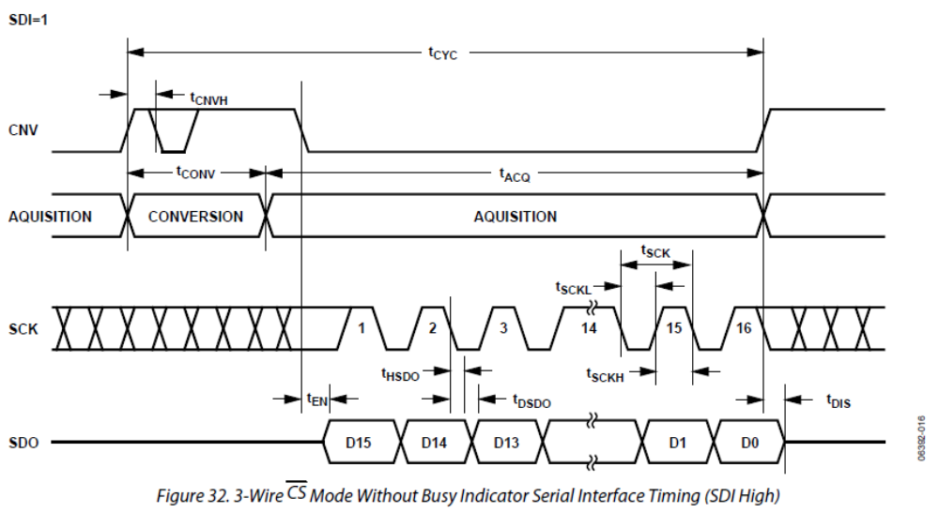
ADC Serial Interface

Slide 42
Timing Specifications
Conversion Time (t_{CONV}): 500-710 ns
Acquisition Time (t_{ACQ}): 290-500 ns
Cycle Time (t_{CYC}): 1000 ns minimum (1MSps)
Clock Period (t_{SCK}): 12 ns minimum (83.33MHz)
For 1MSps throughput, maximum clock period is:
(t_{CYC}-t_{CONV,MAX})/16 = 290/16 = 18.125 ns
Minimum clock frequency is 55.17MHz
Next integer multiple of 1MHz is 56MHz
Clock frequencies from 56MHz to 83MHz should work
However…

Slide 43
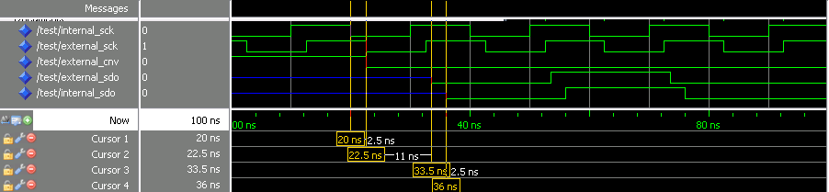
Timing Specifications
ADC Clock Falling Edge to Old Data Invalid (t_{HSDO}): 3 ns
ADC Clock Falling Edge to New Data Valid (t_{DSDO}): 11 ns
Spartan 3 & 3E I/O Delay (Measured): ~2.5 ns
This results in a round trip delay of ~16 ns.
This effectively limits the serial clock frequency to between 56MHz and 62MHz (assuming 1MSps is desired).
Faster clock speeds could theoretically be used by increasing the Spartan 3E’s IBUF_DELAY_VALUE parameter and pipelining…

Slide 44
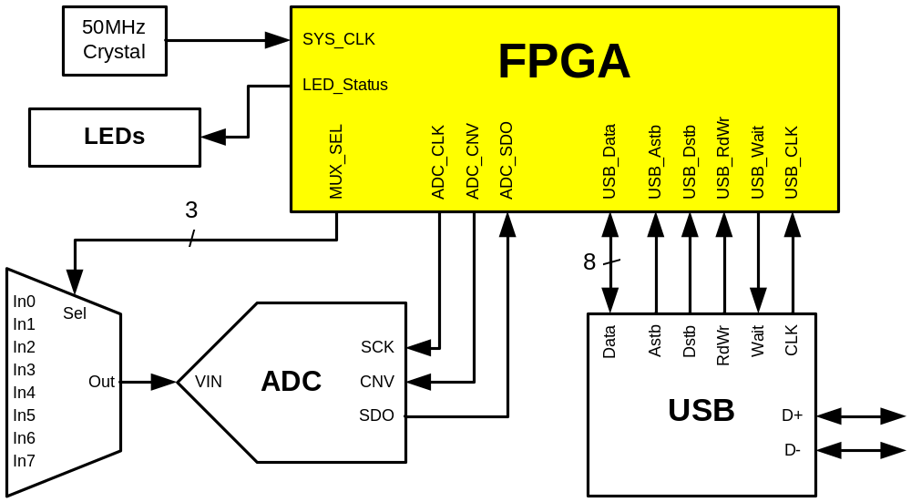
FPGA Logic

Slide 45
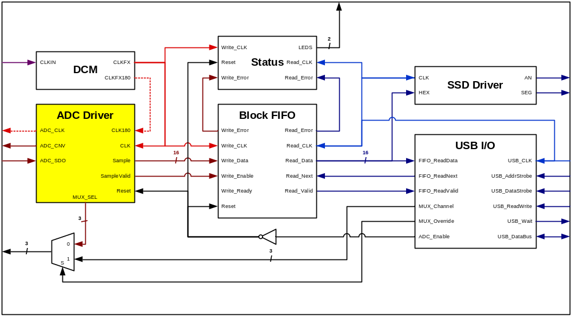
FPGA Logic (ADC Driver)

Slide 46
ADC Driver
A custom VHDL entity was created to control the ADC and analog multiplexer.
Clock frequency and desired sample rate can be specified using generics.
A simple linear state machine controls the conversion / acquisition process.
  Each state lasts a fixed number of clock cycles.
  The number of clock cycles for each state are determined at compile time
A counter process is used to control state transitions.

Slide 47
ADC Driver State Machine
Simple three-state Mealy Machine.
Contains the following states:
  STARTUP: Initialization state. Used during reset to ensure that the ADC itself is in a known state. Stays in this state for at least 1000 ns (1 complete sample period).
  CONV_WAIT: Wait state for ADC conversion phase. Remains in this state for at least 710ns. The multiplexer channel is incremented at the end of this state.
  ACQ_SHIFT: Acquisition state. Data is serially shifted out of the ADC and into an internal shift register. This state is always 16 clock cycles. The resulting sample data is stored at the end of this state.

Slide 48
ADC Driver State Machine
The state machine has the following input:
  TimerPulse: Instructs state machine to transition states.
The state machine has the following outputs:
  Convert: Instructs ADC to begin an analog to digital conversion.
  ClockEnable: Enable signal for the serial clock tri-state buffer.
  SampleValid: Status flag indicating that the shift register contains a complete sample. External logic monitors this signal and copies the sample to memory when SampleValid goes high.
  IncrementMux: Control flag instructing an up-counter to increment the analog multiplexer channel select signal.

Slide 49
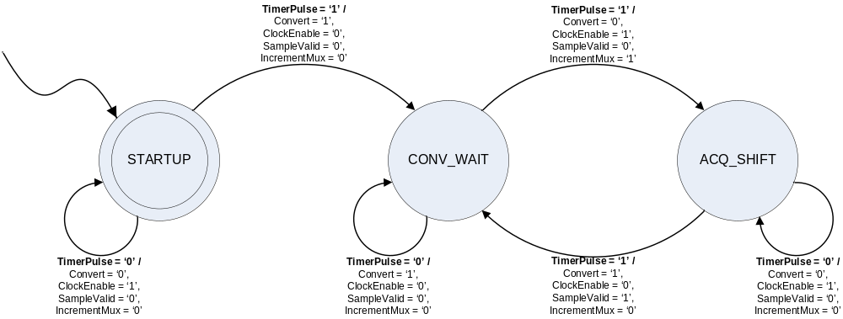
ADC Driver State Machine

Slide 50
ADC Driver Parameters
The clock frequency and desired sample rate are passed in as VHDL generics.
  ADC_CLK_FREQ := 60_000_000;
  SAMPLE_RATE := 1_000_000;
The number of clock cycles for the STARTUP and CONV_WAIT states are automatically calculated at compile time based on these generics.
Assert statements are also used to ensure valid values are entered and that ADC timing requirements are met.

Slide 51
ADC Driver Constants
-- Period of each complete convert + acquire cycle.
constant SAMPLE_PERIOD : real := 1.0/SAMPLE_RATE;
-- Number of clock cycles spent in the acquisition state.
constant ACQ_CYCLES : real := 16;
-- Time spent in the acquisition state.
constant ACQ_TIME : real := ACQ_CYCLES/ADC_CLK_FREQ;
-- Time spent in the conversion state.
constant CNV_TIME : real := REALMAX(710.0e-9,
SAMPLE_PERIOD - ACQ_TIME);
-- Number of clock cycles spent in the conversion state.
constant CNV_CYCLES : real := ceil(CNV_TIME * ADC_CLK_FREQ);
-- Total number of cycles per sample.
constant SAMPLE_CYCLES : real := (ACQ_CYCLES + CNV_CYCLES);
-- Actual number of samples captured per second.
constant ACTUAL_RATE : real := ADC_CLK_FREQ / SAMPLE_CYCLES;

Slide 52
ADC Driver Counter
A synchronous up-counter is used to control state transitions.
  The output of the counter is compared with a value based on the current state
  (auto-computed from VHDL generics).
  When the counter reaches the compare value a terminal pulse is generated.
  This pulse automatically resets the counter and triggers a state transition.
  The state transition causes the next auto-computed compare value to be loaded.

Slide 53
ADC Driver Counter
TimerProcess: process(CLK)
begin
if ( Rising_Edge(CLK) ) then
if ( RST = '1' or TimerPulse = '1' ) then
TimerValue <= (others => '0');
else
TimerValue <= TimerValue + 1;
end if;
end if;
end process;
TimerPulse <= '1' when (TimerValue = TimerCompare) else '0';
TimerCompare_Mux: process(CurrentState)
begin
case (CurrentState) is
when ADC_IDLE_WAIT =>
TimerCompare <= IDLE_WAIT_TIMER_COMP;
when ADC_CONV_WAIT =>
TimerCompare <= CONV_WAIT_TIMER_COMP;
when ADC_ACQ_SHIFT =>
TimerCompare <= ACQ_SHIFT_TIMER_COMP;
when others =>
TimerCompare <= IDLE_WAIT_TIMER_COMP;
end case;
end process;

Slide 54
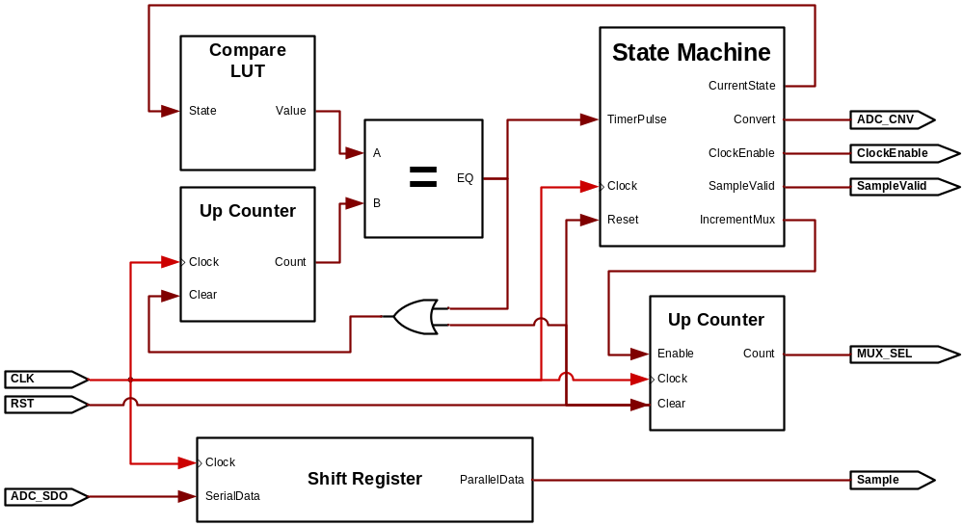
ADC Driver Block Diagram

Slide 55
ADC Driver Clock Signals
The internal FPGA logic and the external serial clock both run at 60MHz.
  The internal logic is rising edge sensitive.
  The ADC serial logic is falling edge sensitive.
  Two separate clocks are used: one being 180 degrees out of phase with the other (inverted).
A Xilinx DCM is used to generate both 60MHz clocks from the 50MHz system clock.
  This allows both clock signals to be globally routed using dedicated clock nets.
  This also avoids the delay that would result if logic were used to perform the inversion.

Slide 56
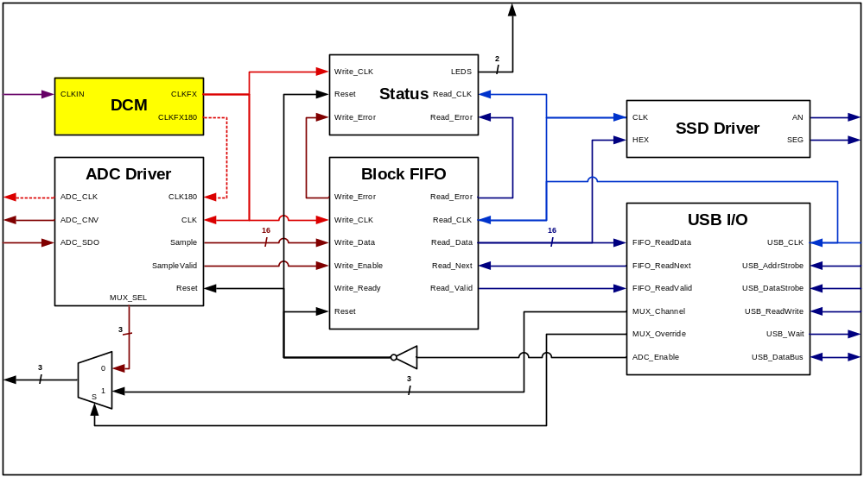
ADC Driver Clock Signals

Slide 57
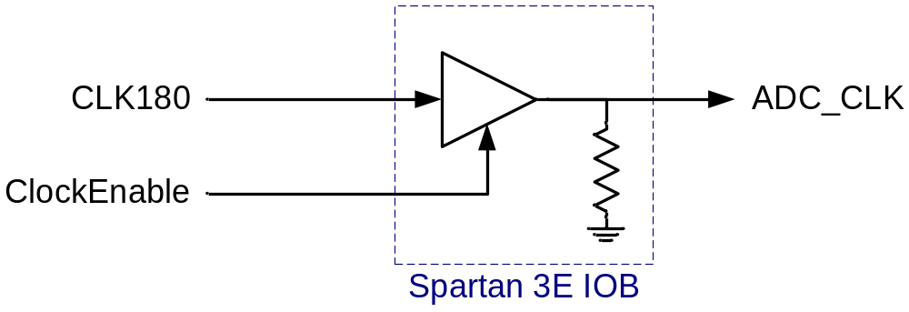
ADC Driver Clock Signals
The serial clock is only enabled during the acquisition state.
During the conversion state, the clock signal is held low.
  This helps reduce digital noise while the ADC is sampling.
The tri-state buffer in the Spartan 3E output block is used along with an internal pulldown resistor to accomplish this.
  This method avoids routing the clock through internal logic (lookup tables) and thus prevents clock skew.

Slide 58
FPGA Clock Domains
This design contains two different clock domains.
  60MHz Clock for ADC Control Logic
  48MHz Clock for USB Control Logic
A synchronization method is needed to pass data between the clock domains while avoiding metastability issues.
  For single-bit signals, this is as simple as using two cascaded flip-flops.
  For multi-bit signals, more complex logic is necessary.

Slide 59
FPGA Clock Domains
One possible synchronization method:
  A multi-bit memory element can be utilized to store one or more data words that need to cross domains.
  Data is written to the memory element until it is filled.
  Once filled, a status signal is generated in the write domain and transferred to the read domain using the cascaded flip-flop method.
  Data is then read until the memory element is empty.
  An acknowledge signal is then generated and passed back to the write domain.
The dual-ported nature of the Xilinx BRAM makes it well suited for this purpose.

Slide 60
Block FIFO
This method can be extended by utilizing multiple blocks of memory.
  Read/Write status signals exist for each block of memory.
  When one block of memory is filled, the write domain sets the appropriate status bit and moves on to the next block.
  Similarly, the read domain empties a block at a time, and acknowledges each complete read.
  This creates a multi-block FIFO structure similar to the one in the Cypress USB chip.
This method is used to transfer blocks of samples from the ADC clock domain to the USB clock domain.
  The block size was chosen to be an integer multiple of the USB packet size (512 bytes).
  A total of 32KB of Block RAM was dedicated to this purpose.

Slide 61
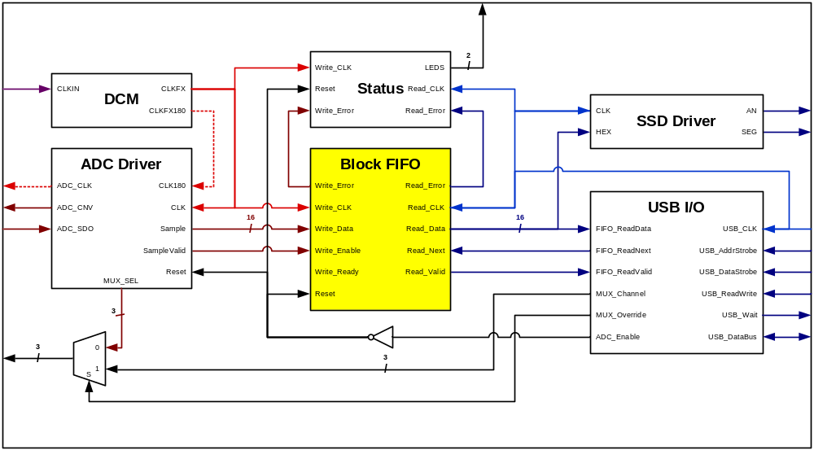
Block FIFO

Slide 62
Block FIFO
Read Signals
  ReadCLK: Clock signal used to control the data read logic.
  ReadNext: Read next signal. The read pointer is incremented and the next unit of data will be output on the rising edge of ReadCLK. One unit of data can be removed from the FIFO every clock cycle if this signal is connected to ReadDataValid.
  ReadDataValid: Status signal; if this signal is high, ReadData contains valid data to be read.
  ReadError: Status signal; if this signal is high, a read was attempted on an empty FIFO.
  ReadData: Data output signal. 16 bits wide.

Slide 63
Block FIFO
Write Signals
  WriteCLK: Clock signal used to control the data write logic.
  WriteEnable: Write enable signal. One unit of data can be added to the FIFO on every rising edge of WriteCLK that this signal is high.
  WriteReady: Status signal; if this signal is high, there is free space in the FIFO to store data.
  WriteError: Status signal; if this signal is high, a write was attempted when the FIFO was full.
  WriteData: Data input signal. 16 bits wide.

Slide 64
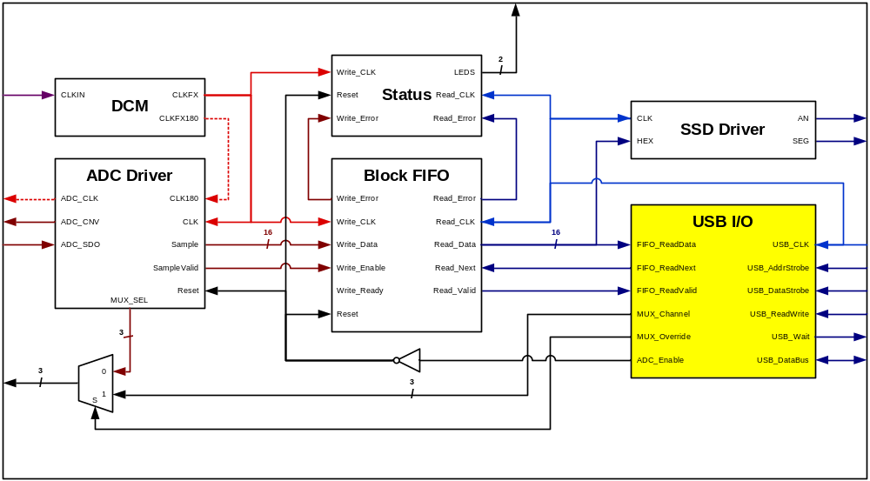
USB I/O

Slide 65
Digilent USB (ADC Version)
Digilent USB State Machine was modified to control the ADC Driver and continuously stream ADC samples to the PC (16Mbps).
  The address write functionality was replaced with a command register structure.
  The read data functionality was redesigned to extract 16-bit data samples from the FIFO.
  The write data and read address modes are unnecessary and were replaced with dummy states (read/write zeros).

Slide 66
USB State Machine
State Machine contains the following inputs:
  USB_Direction: Specifies direction of USB transfer
  (1=FPGA->USB, 0=USB->FPGA).
  USB_AddrStrobe: Address Strobe (active low). Used to write data to the command register when USB_Direction = ‘0’.
  USB_DataStrobe: Data strobe (active low). Used to read samples from the Block FIFO when USB_Direction = ‘1’.
  ADC_GettingData: Status flag indicating whether data should be retrieved from the Block FIFO.
  ReadingDataMSB: Status flag indicating whether the MSB or LSB of ADC sample should be output.
  FIFO_ReadDataValid: Status flag indicating whether more samples are available to be read from the Block FIFO.

Slide 67
USB State Machine
State Machine contains the following outputs:
  OutputEnable: Output enable for USB data bus
  (active high, tri-state control).
  WaitOutput: Wait output pin (active high).
  OutputDataMux: Control flag indicating whether to output sample data (1) or dummy data (0) to bus.
  CommandUpdate: Control flag indicating if incoming data should be stored to the command register (active high).
  ReadDataMSB: Control flag indicating that a sample should be read from the FIFO and the MSB should be output to the data bus (active high).
  ReadDataLSB: Control flag indicating that the previously stored LSB should be output to the data bus (active high).

Slide 68
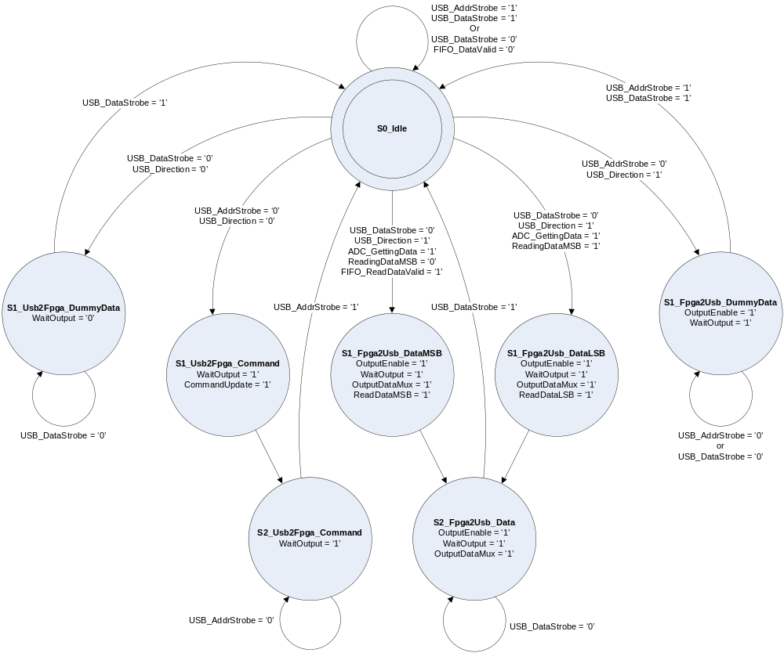
USB State Diagram

Slide 69
USB Commands
The following commands were implemented:
  CMD_StopADC: Disables the ADC and Block FIFO by holding the Reset signal high.
  CMD_StartADC: Enables the ADC and Block FIFO by bringing the Reset signal low.
  CMD_GetSamples: Specifies that subsequent read data operations will return ADC samples from the FIFO.
  CMD_SetChannel: Can be used to override the analog multiplexer channel used. The selected channel and override flag are stored in the upper nibble of the command byte.

Slide 70
USB Command Parsing
CommandParseProcess: process(USB_CLK)
begin
if ( Rising_Edge(USB_CLK) ) then
case(usbCommandRegister(CMDRange)) is
when CMD_StopADC =>
ADC_Running <= '0';
ADC_GettingData <= '0';
when CMD_StartADC =>
ADC_Running <= '1';
ADC_GettingData <= '0';
when CMD_GetSamples =>
ADC_Running <= ADC_Running;
ADC_GettingData <= ADC_Running;
when others =>
ADC_Running <= ADC_Running;
ADC_GettingData <= ADC_GettingData;
end case;
end if;
end process;

Slide 71
Multiplexer Control Process
MuxControlProcess: process(USB_CLK)
begin
if ( Rising_Edge(USB_CLK) ) then
case(usbCommandRegister(CMDRange)) is
when CMD_StartADC =>
MUX_Channel_i <= usbCommandRegister(MUXRange);
MUX_Override_i <= usbCommandRegister(MUXOverrideBit);
when CMD_SetChannel =>
MUX_Channel_i <= usbCommandRegister(MUXRange);
MUX_Override_i <= usbCommandRegister(MUXOverrideBit);
when others =>
MUX_Channel_i <= MUX_Channel_i;
MUX_Override_i <= MUX_Override_i;
end case;
end if;
end process;

Slide 72
Data Control Process
DataProcess: process(USB_CLK)
begin
if ( Rising_Edge(USB_CLK) ) then
if ( ADC_Running = '0') then
DataOut <= (others => '0');
DataLSB <= (others => '0');
ReadingDataMSB <= '0';
elsif ( ReadDataMSB = '1' ) then --only read from FIFO in MSB read state
DataOut <= FIFO_ReadData(15 downto 8);
DataLSB <= FIFO_ReadData(7 downto 0); --store LSB for next USB transfer
ReadingDataMSB <= '1';
elsif ( ReadDataLSB = '1' ) then
DataOut <= DataLSB;
DataLSB <= DataLSB; --transfer the stored LSB and don't read from FIFO
ReadingDataMSB <= '0';
else
DataOut <= DataOut;
DataLSB <= DataLSB;
ReadingDataMSB <= ReadingDataMSB;
end if;
end if;
end process;

Slide 73
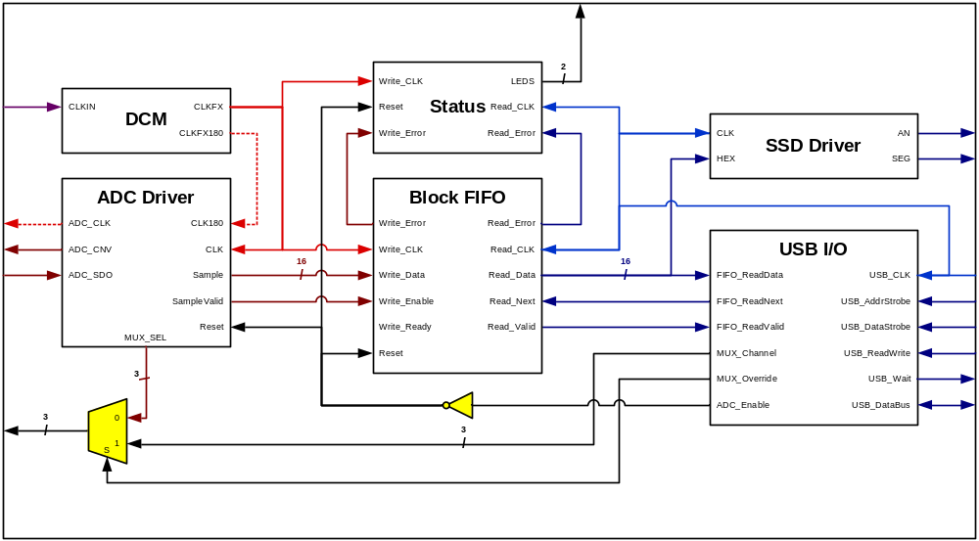
USB ADC Control

Slide 74
Digilent DPCUtil API
For PC applications to communicate using the Digilent protocol, use dpcutil.dll that comes with the Adept Software Suite
API DLL written in MS Visual C++ 6.0
For use in C#, a DLL wrapper is required
First step is initialization with DpcInit()
Last step is termination with DpcTerm()
Wrapper and ADC read code was written using MS Visual Studio 2005 in C#

Slide 75
Digilent Port Communications Wrapper
static class DPCUtil
{
…
// DPC Stuff
[DllImport("dpcutil.dll")]
public static extern bool DpcInit( out int ErrorCode );
[DllImport("dpcutil.dll")]
public static extern void DpcTerm();
[DllImport("dpcutil.dll")]
public static extern bool DpcGetDpcVersion( StringBuilder VersionString, out int ErrorCode );
[DllImport("dpcutil.dll")]
public static extern bool DpcStartNotify( IntPtr hwndTemp, ushort idNotifyTemp, out int ErrorCode );
[DllImport("dpcutil.dll")]
public static extern bool DpcEndNotify( IntPtr hwndTemp, out int ErrorCode );
[DllImport("dpcutil.dll")]
public static extern bool DpcGetVersion( IntPtr InterfaceHandle, byte[] rgbVersion, int cbVersion, out int ErrorCode, UIntPtr TransactionID );
[DllImport("dpcutil.dll")]
public static extern int DpcGetFirstError( IntPtr InterfaceHandle );
…
BOOL DpcGetDpcVersion (char * szVersion,
ERC *perc)

Slide 76
DPC Wrapper
…
// Data Transfer Stuff
[DllImport("dpcutil.dll")]
public static extern bool DpcOpenData( out IntPtr InterfaceHandle, StringBuilder DeviceName, out int ErrorCode, UIntPtr TransactionID );
[DllImport("dpcutil.dll")]
public static extern bool DpcCloseData( IntPtr InterfaceHandle, out int ErrorCode );
[DllImport("dpcutil.dll")]
public static extern bool DpcPutReg( IntPtr InterfaceHandle, byte Address, byte Data, out int ErrorCode, UIntPtr TransactionID );
[DllImport("dpcutil.dll")]
public static extern bool DpcGetReg( IntPtr InterfaceHandle, byte Address, out byte Data, out int ErrorCode, UIntPtr TransactionID );
[DllImport("dpcutil.dll")]
public static extern bool DpcPutRegRepeat( IntPtr InterfaceHandle, byte Address, byte[] DataArray, int DataLength, out int ErrorCode, UIntPtr TransactionID );
[DllImport("dpcutil.dll")]
public static extern bool DpcGetRegRepeat( IntPtr InterfaceHandle, byte Address, byte[] DataArray, int DataLength, out int ErrorCode, UIntPtr TransactionID );
…
}

Slide 77
Initialization/Termination
private bool DPC_Init()
{
int ErrorCode;
int DeviceID;
if ( !DPCUtil.DpcInit(out ErrorCode) )
{
return false;
}
DeviceID = DPCUtil.DvmgGetDefaultDev(out ErrorCode);
if ( DeviceID == -1 )
{
return false;
}
else
{
DPCUtil.DvmgGetDevName(DeviceID, DefaultDeviceName, out ErrorCode);
return true;
}
}
private void MainForm_FormClosed( object sender, FormClosedEventArgs e )
{
DPCUtil.DpcTerm();
}

Slide 78
Read a Register
public bool DPC_GetReg( byte RegisterAddress, ref byte RegisterData )
{
int ErrorCode;
IntPtr InterfaceHandle;
bool Success = true;
if ( !DPCUtil.DpcOpenData(out InterfaceHandle, DefaultDeviceName, out ErrorCode, UIntPtr.Zero) )
return false;
if ( !DPCUtil.DpcGetReg(InterfaceHandle, RegisterAddress, out RegisterData, out ErrorCode, UIntPtr.Zero) )
Success = false;
DPCUtil.DpcCloseData(InterfaceHandle, out ErrorCode);
return Success;
}

Slide 79
Write a Register
public bool DPC_PutReg( byte RegisterAddress, byte RegisterData )
{
int ErrorCode;
IntPtr InterfaceHandle;
bool Success = true;
if ( !DPCUtil.DpcOpenData(out InterfaceHandle, DefaultDeviceName, out ErrorCode, UIntPtr.Zero) )
return false;
if ( !DPCUtil.DpcPutReg(InterfaceHandle, RegisterAddress, RegisterData, out ErrorCode, UIntPtr.Zero) )
Success = false;
DPCUtil.DpcCloseData(InterfaceHandle, out ErrorCode);
return Success;
}

Slide 80
Read ADC Data
private void CaptureThread_DoWork( object sender, DoWorkEventArgs e )
{
const byte CMD_Stop = 0x00;
const byte CMD_Start = 0x01;
const byte CMD_GetData = 0x02;
BackgroundWorker BW = sender as BackgroundWorker;
CaptureThreadArguments Args = e.Argument as CaptureThreadArguments;
FileStream CaptureFile = new FileStream(Args.FileName, FileMode.Create);
byte[] TempData = new byte[BlockSize];
ulong SampleCount = 0;
long CurrentTicks;
long StartTicks;
IntPtr InterfaceHandle;
int ErrorCode;
byte Dummy;
// Open DPC Stuff
if ( DPCUtil.DpcOpenData(out InterfaceHandle, DefaultDeviceName, out ErrorCode, UIntPtr.Zero) )
{
// Send command to start capture
if ( DPCUtil.DpcGetReg(InterfaceHandle, CMD_Start, out Dummy, out ErrorCode, UIntPtr.Zero) )
{
// Store the start time
StartTicks = System.DateTime.Now.Ticks;

Slide 81
Read ADC Data
while ( !BW.CancellationPending && SampleCount < Args.TotalSamples )
{
ulong SamplesRemaining = Args.TotalSamples - SampleCount;
int NumBytes = (SamplesRemaining > SamplesPerBlock) ? BlockSize : (int)(SamplesRemaining*2);
if ( DPCUtil.DpcGetRegRepeat(InterfaceHandle, CMD_GetData, TempData, NumBytes, out ErrorCode, UIntPtr.Zero) )
{
// Save samples
CaptureFile.Write(TempData, 0, NumBytes);
SampleCount += (ulong)(NumBytes / 2);
CurrentTicks = System.DateTime.Now.Ticks;
// Report the current status of the capture
CaptureProgressArguments ProgArgs = new CaptureProgressArguments();
ProgArgs.LastSample = (ushort)((TempData[TempData.Length-2] << 8) | TempData[TempData.Length-1]);
ProgArgs.Ticks = (CurrentTicks-StartTicks);
ProgArgs.Samples = SampleCount;
BW.ReportProgress(0, ProgArgs);
}

Slide 82
Read ADC Data
else
{
break;
}
}
}
DPCUtil.DpcGetReg(InterfaceHandle, CMD_Stop, out Dummy, out ErrorCode, UIntPtr.Zero);
DPCUtil.DpcCloseData(InterfaceHandle, out ErrorCode);
}
if ( BW.CancellationPending )
{
e.Cancel = true;
}
CaptureFile.Close();
CaptureFile.Dispose();
}

Slide 83
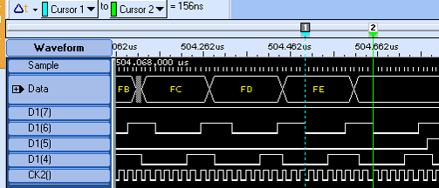
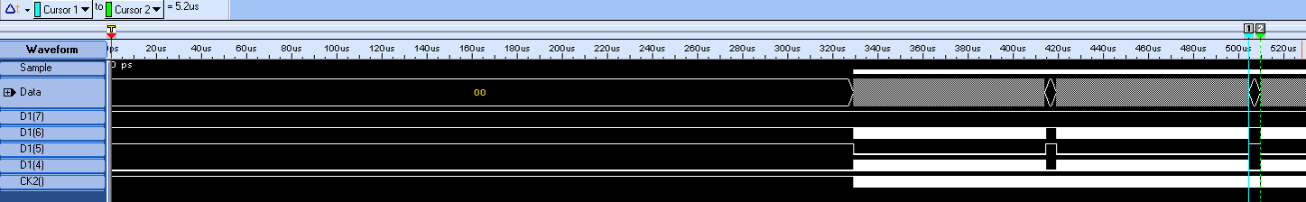
Put Register Repeat Example
Write to register 0x00 4000 times using DPC_PutRegRepeat().
Notice 330us initial delay after writing to address register
5.2us delay between
512 byte chunks
156 ns between bytes

Slide 84
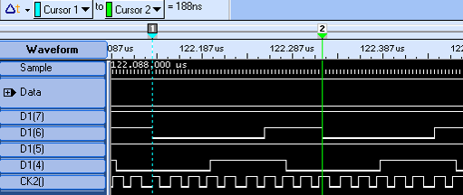
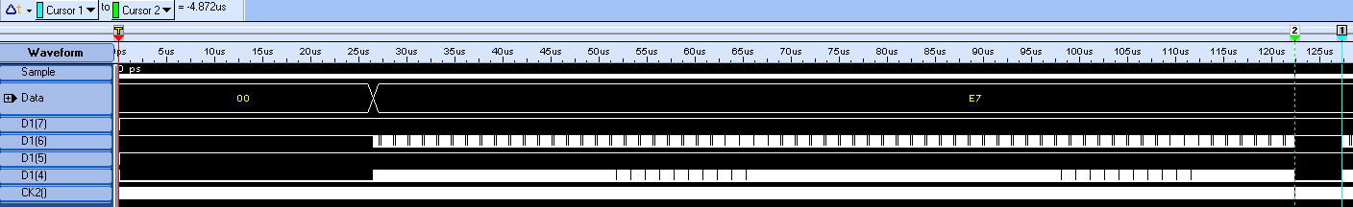
Get Register Repeat Example
Read from register 0x00 1000 times using DPC_GetRegRepeat().
Notice 20us initial delay after writing to address register
4.9us delay between
512 byte chunks
188 ns between bytes

Slide 85
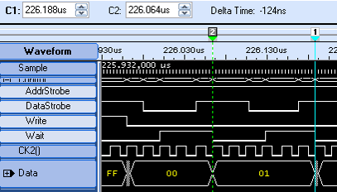
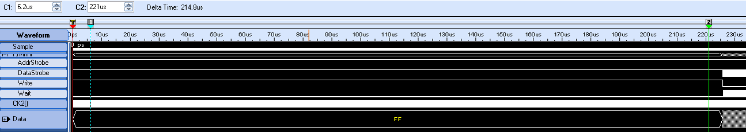
Put Register Repeat Example 2
Write to register 0x00 256 times using DPB_GetRegRepeat() after modifications
Notice 225us delay after writing to address register
124ns between bytes now

Slide 86
Conclusion
We successfully implemented a PC-controlled ADC reader
The original Digilent FPGA USB protocol was modified and improved
We are able to continuously read at 16Mbit/s with no data corruption
Speeds up to 50Mbit/s should be possible with the improved Digilent protocol
Even greater speeds can be achieved with new firmware on the Cypress chip

Slide 87
Sources
Endpoint FIFO Architecture of EZ-USB FX1/FX2™. http://www.cypress.com/?docID=4704
EZ-USB FX2LP™ USB Microcontroller High-Speed USB Peripheral Controller. http://www.cypress.com/?docID=5485
Digilent Parallel Interface Model Reference Manual. http://www.digilentinc.com/Data/AppNotes/DpimRef.pdf
Digilent Port Communications Programmers Reference Manual. http://www.digilentinc.com/Data/Products/ADEPT/DPCUTIL%20Programmers%20%20Reference%20Manual.pdf
Nexys2_sch.pdf. http://www.digilentinc.com/Data/Products/NEXYS2/Nexys2_sch.pdf
Digilent Nexys2 Board Reference Manual. http://www.digilentinc.com/Data/Products/NEXYS2/Nexys2_rm.pdf
FPGA Resources. Echelon Embedded. http://www.echelonembedded.com/fpgaresources/
USB Protocol Specification. http://www.faculty.iu-bremen.de/birk/lectures/PC101-2003/14usb/FINAL%20VERSION/usb_protocol.html
Universal Serial Bus. http://en.wikipedia.org/wiki/Usb

Slide 88
Questions?

